Slide 1
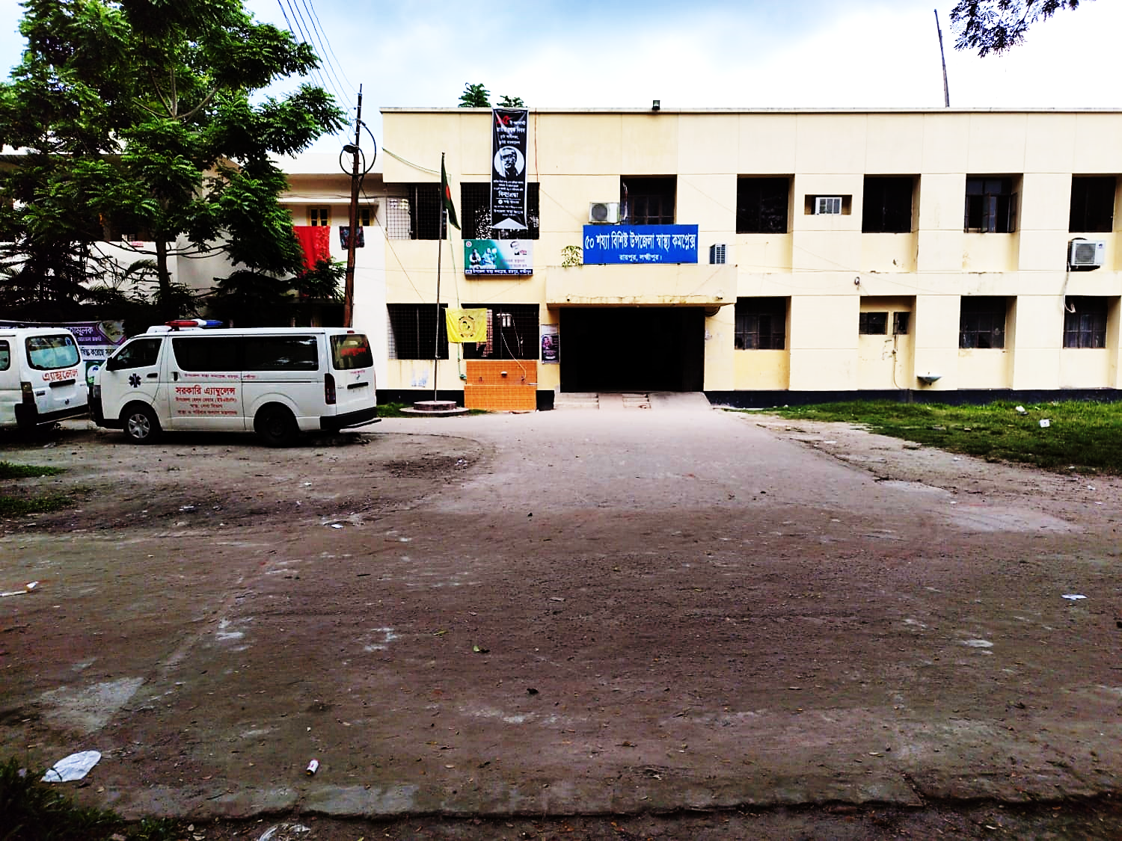
50 BEDED UPAZILA HEALTH COMPLEX
Raipur, Lakshmipur.

Slide 2
Health Profile of Raipur Upazila- 2021
Total population : 313760
Total Fertile Couples : 59735
Total Pregnant : 7644
Total Delivery : 7618
Total Live birth : 7599
Total death : 1011
Total Maternal death : 01
9. Health Institutions
a. Health Complex : 01
b. H & FWC : 10 (RD- 2 + FWC– 8 )
c. Community clinic : 34
d. Non- Govt. Clinic : 14 ( 9 + 5 )

Slide 3
Health Profile of Raipur Upazila- 2021 cont.
10. Mother Taken-ANC : 98.70% (7545) ( 1st Visit)
11. Hospital Delivery Rate : 49.33% (3749)
12. Total C. Section rate : 46.5% (441) -UHC
13. No. of Hospital bed : 50
14. Bed Occupancy Rate : 104%
15. Maternal Mortality Ratio : 13.16/ 100000 live Birth (1)
16. Neonatal Mortality Rate : 1.71/ 1000 live birth (13)
17. Infant Mortality Rate : 3.42/1000 live birth (26)
18. Under-5 Mortality Rate : 5.79/1000 live birth(44)

Slide 4
Human Resourse
Doctor :22
Nurse :22
HA,AHI,HI :37
SBA :25( 4HA+ 21 FWA )
Security guard : 01
Cleaner :03
MLSS :01
Lab attendant :01
Em. attendant :01
OT boy :01
Aya :01
Mali 01
Outsourcing :04

Slide 5
A Sub-district level Hospital with a Vision
Maximum utilization of Govt.
resources with
honesty and sincerity
Integrated approach of
Administration, Community
Leaders & Health
Management
Providing Effective and
prompt services
through improved
management system

Slide 6
Background History of Raipur UHC
The hospital started as 31 bedded THC in 1978.
THC upgraded to UHC in 1982.
From Dec. 1999 Reproductive Health Department of DGHS and UNICEF gave logistic supports and human resource.
Form November 2000, started Comprehensive EOC program.
Safe Blood Transfusion unit established in 2008.
Demand Side Financing (DSF) program started in 2008.
Hospital is upgraded to 50 bedded hospital in 2008

Slide 7
Contd.
The UHC was awarded the ‘Health Minister’s Award’’ for Community Health Services in Chittagong division in 2017.
NCD Corner started on 1st January-2021
KMC and SAM corner started in January 2021.
Essential packages for ANC patients started in August 2021.

Slide 8
UHC
Bed Occupancy Rate from 2018 to 2022

Slide 9
Emergency, Indoor & Out Door Service 2018 to 2022
UHC

Slide 10
Comparative data of revenue income (in Taka) from 2018 to 2022
Raipur UHC

Slide 11
Upazila Health Complex
Raipur,Lakshmipur.
EOC Activities: 2018-2022 (Total Hospital Delivery )

Slide 12
Upazila Health Complex
Raipur,Lakshmipur.
EOC Activities: 2018-2021 (Normal Delivery )

Slide 13
Upazila Health Complex
Raipur, Lakshmipur
EOC Activities: 2018-2021 (Caesarian Section)

Slide 14
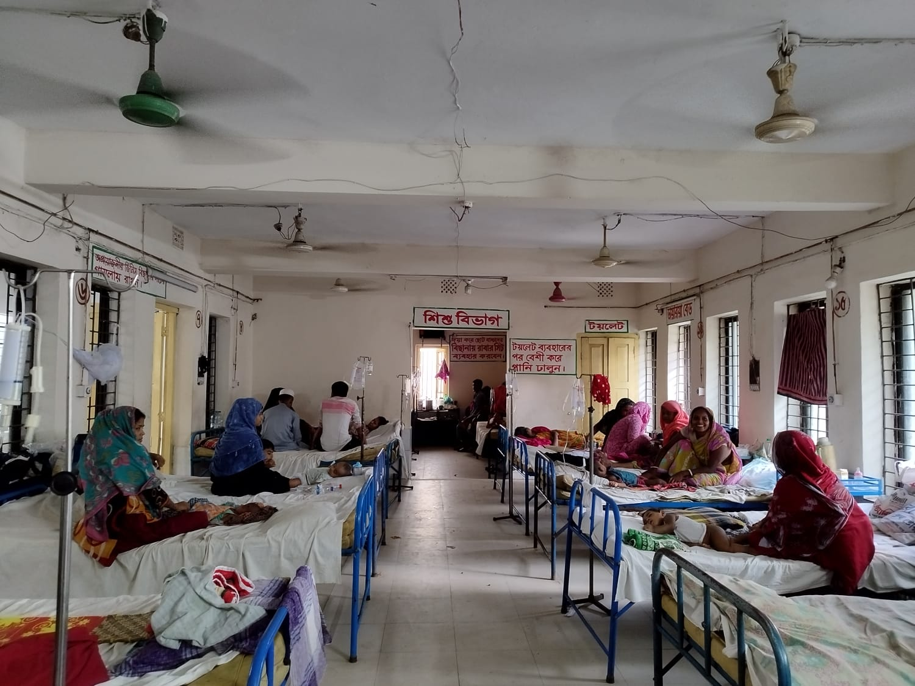
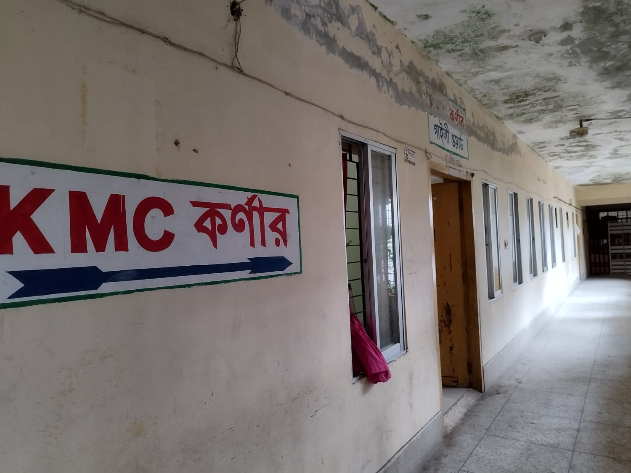
Ward and Indoor
Indoor
KMC CORNER

Slide 15
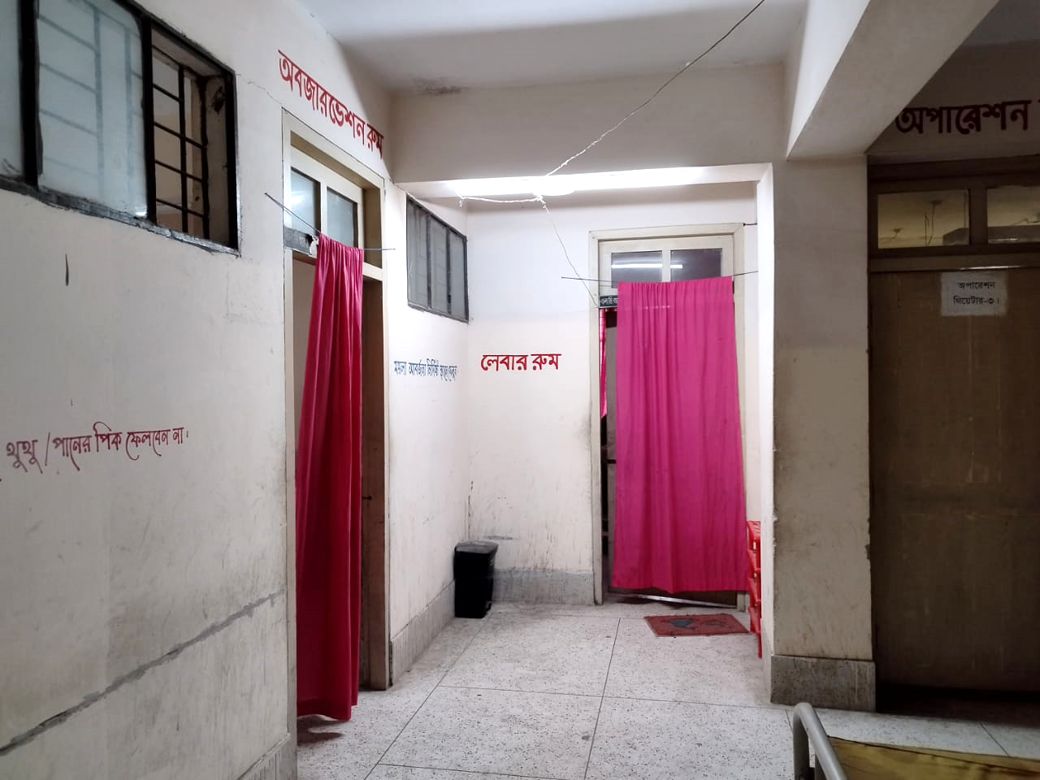
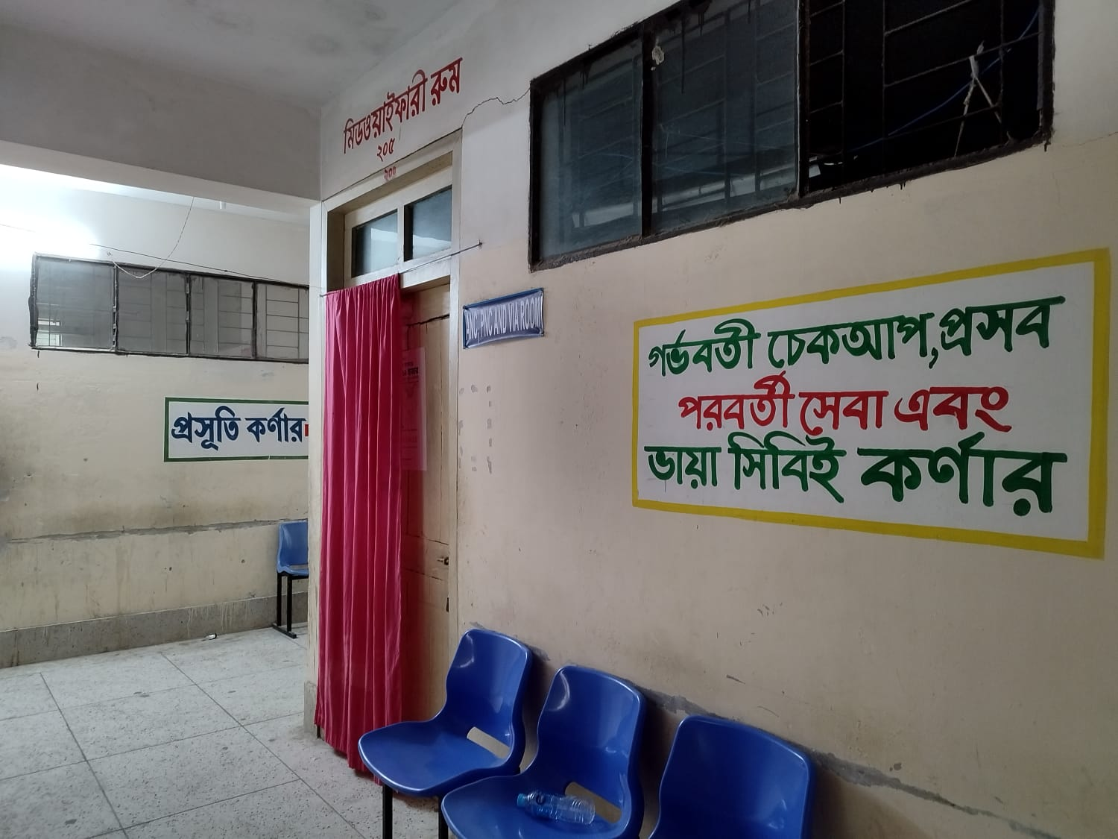
MCH SERVICES OF HOSPITAL
LABOR ROOM
ANC & PNC ROOM

Slide 16
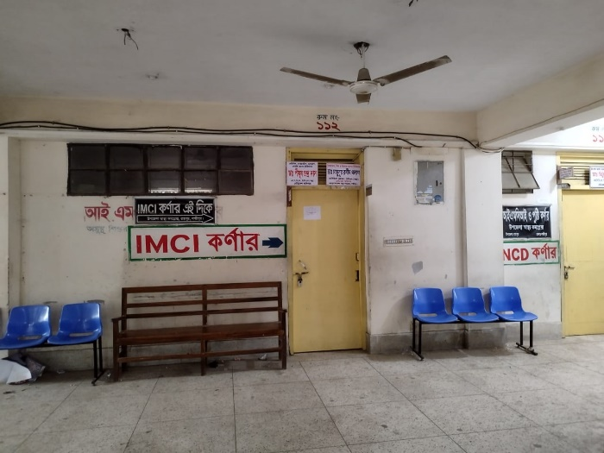
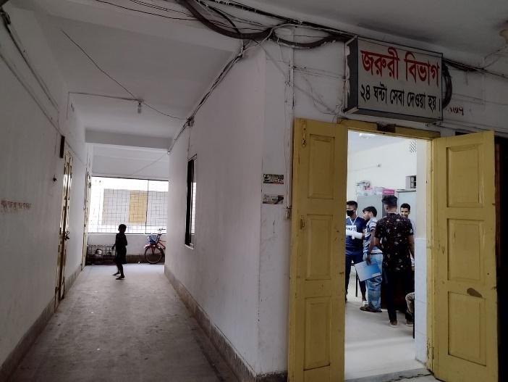
OUTDOOR & EMERGENCY AREA
OUTDOOR & IMCI
EMERGENCY AREA

Slide 17
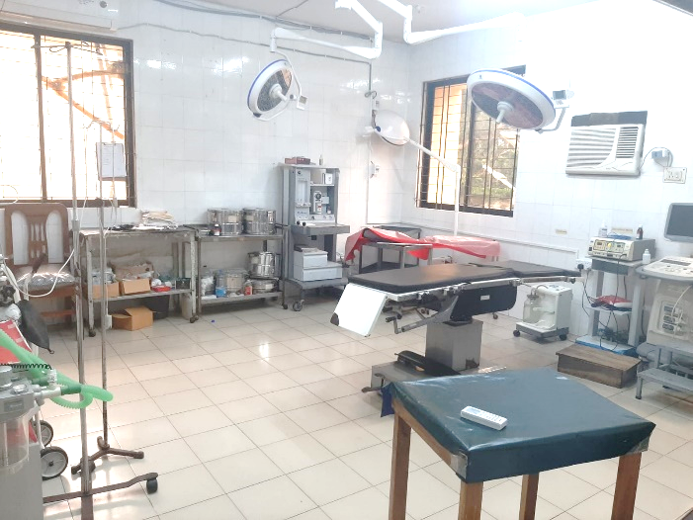
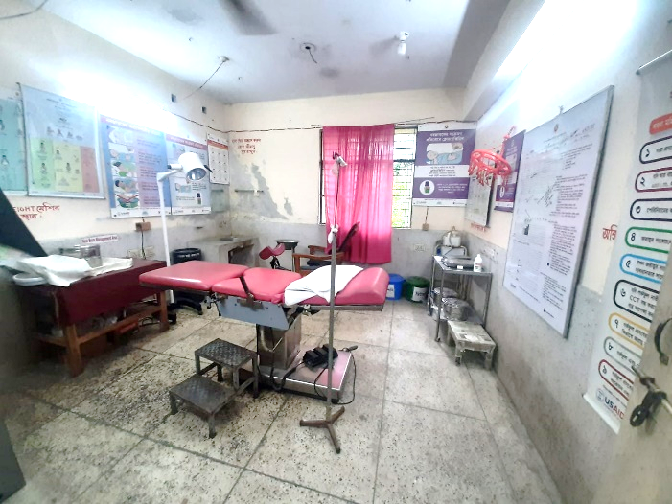
LABOR ROOM AND OT COMPLEX
OT ROOM
LABOR ROOM

Slide 18
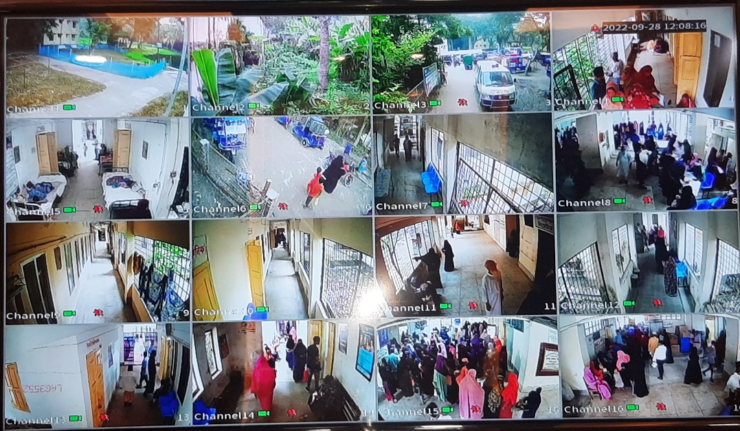
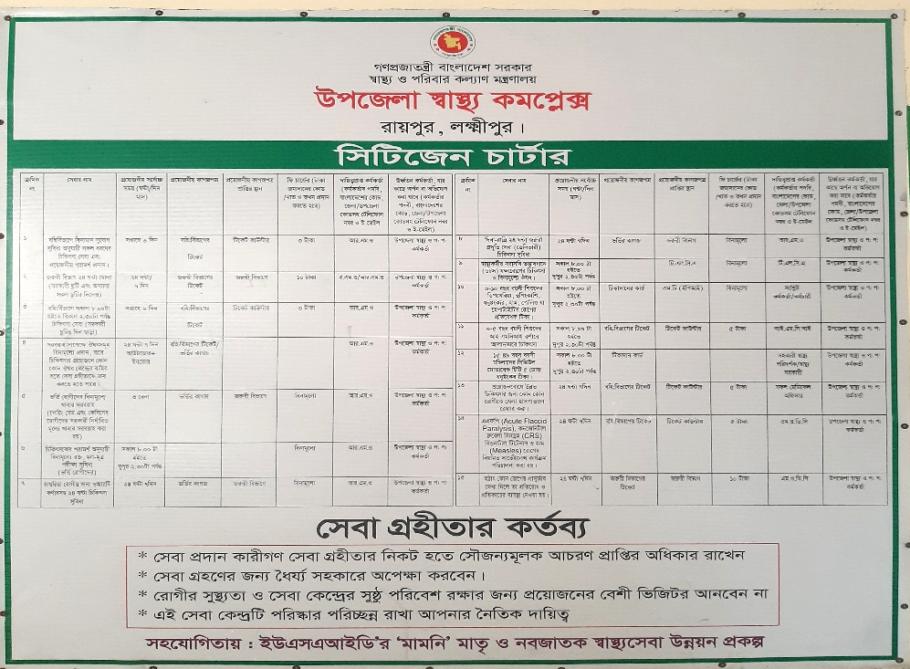
INTERNAL MONITORING SYSTEM AND CITIZEN CHART
CC CAMERA
CHITIZEN CHARTER

Slide 19
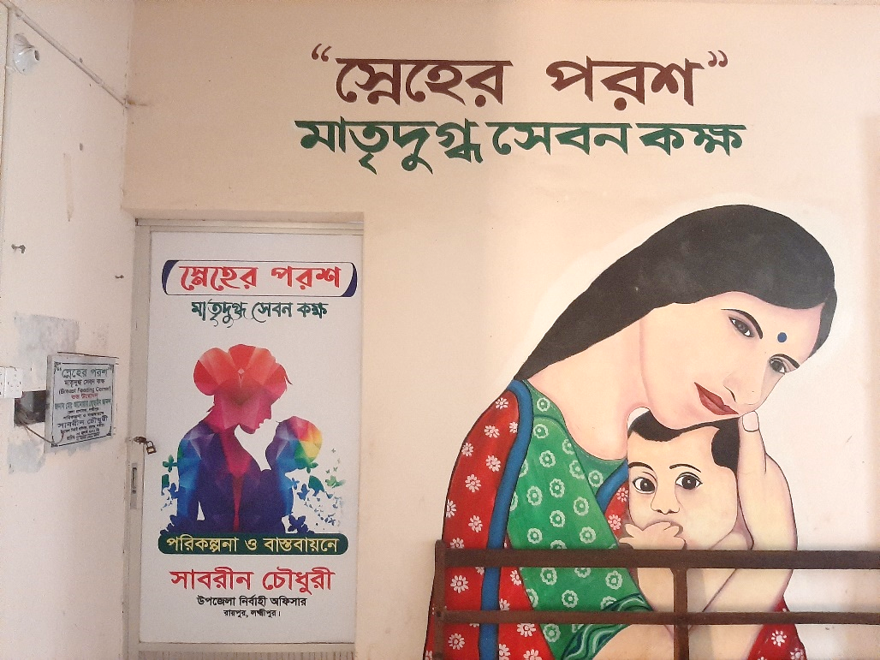
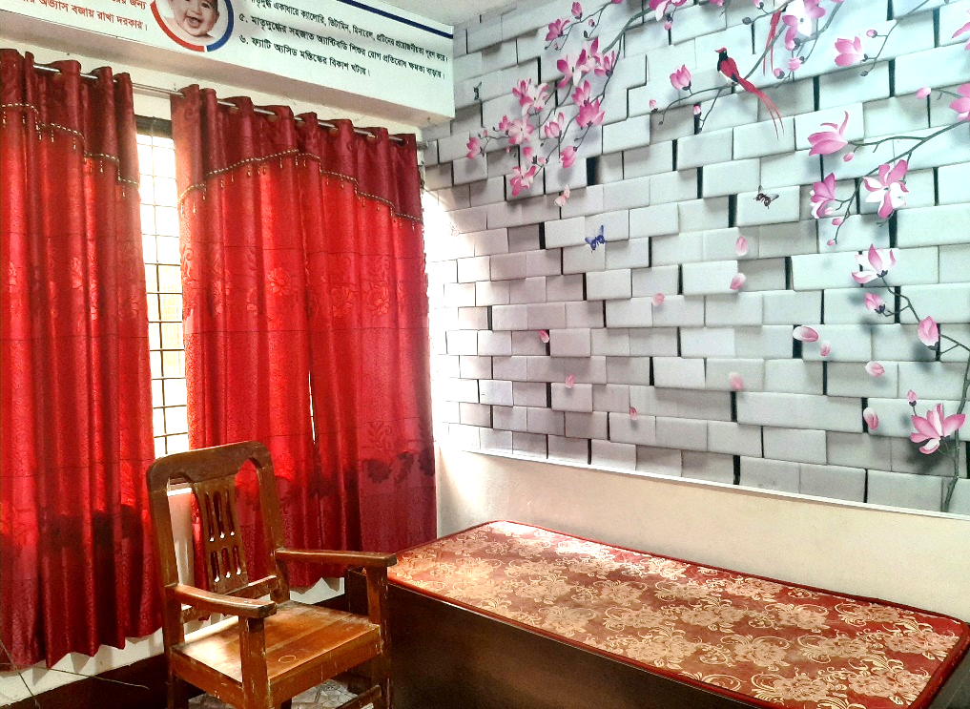
BREASTFEEDING CORNER
OUTSIDE AREA
INSIDE AREA

Slide 20
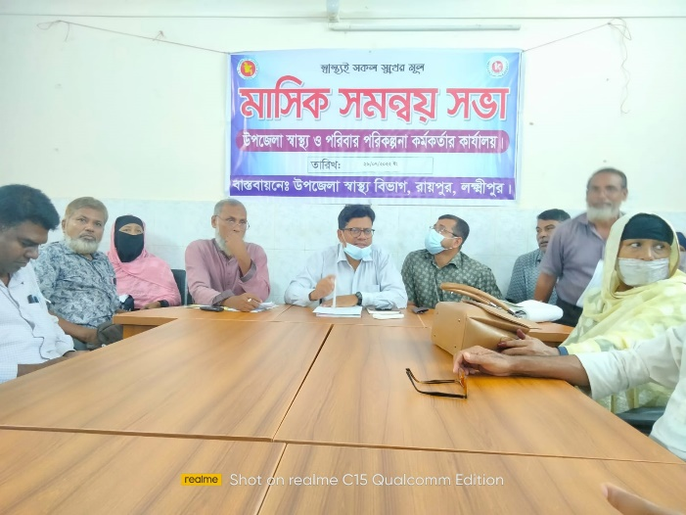
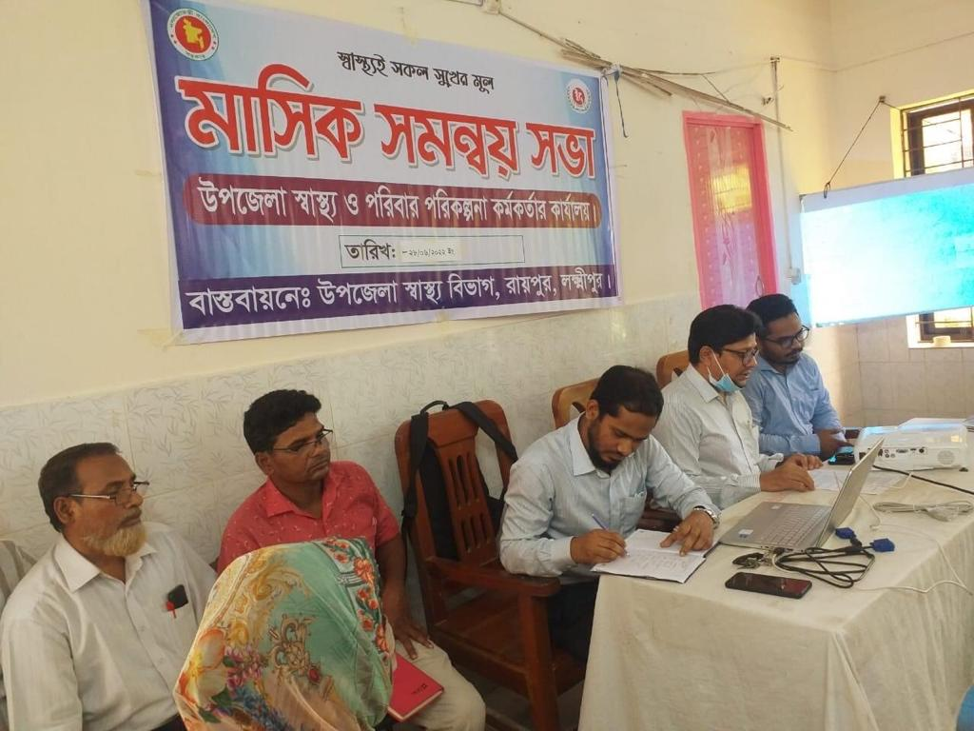
QUALITY IMPROVEMENT MEETING
STAFF MEETING
STAFF MEETING

Slide 21
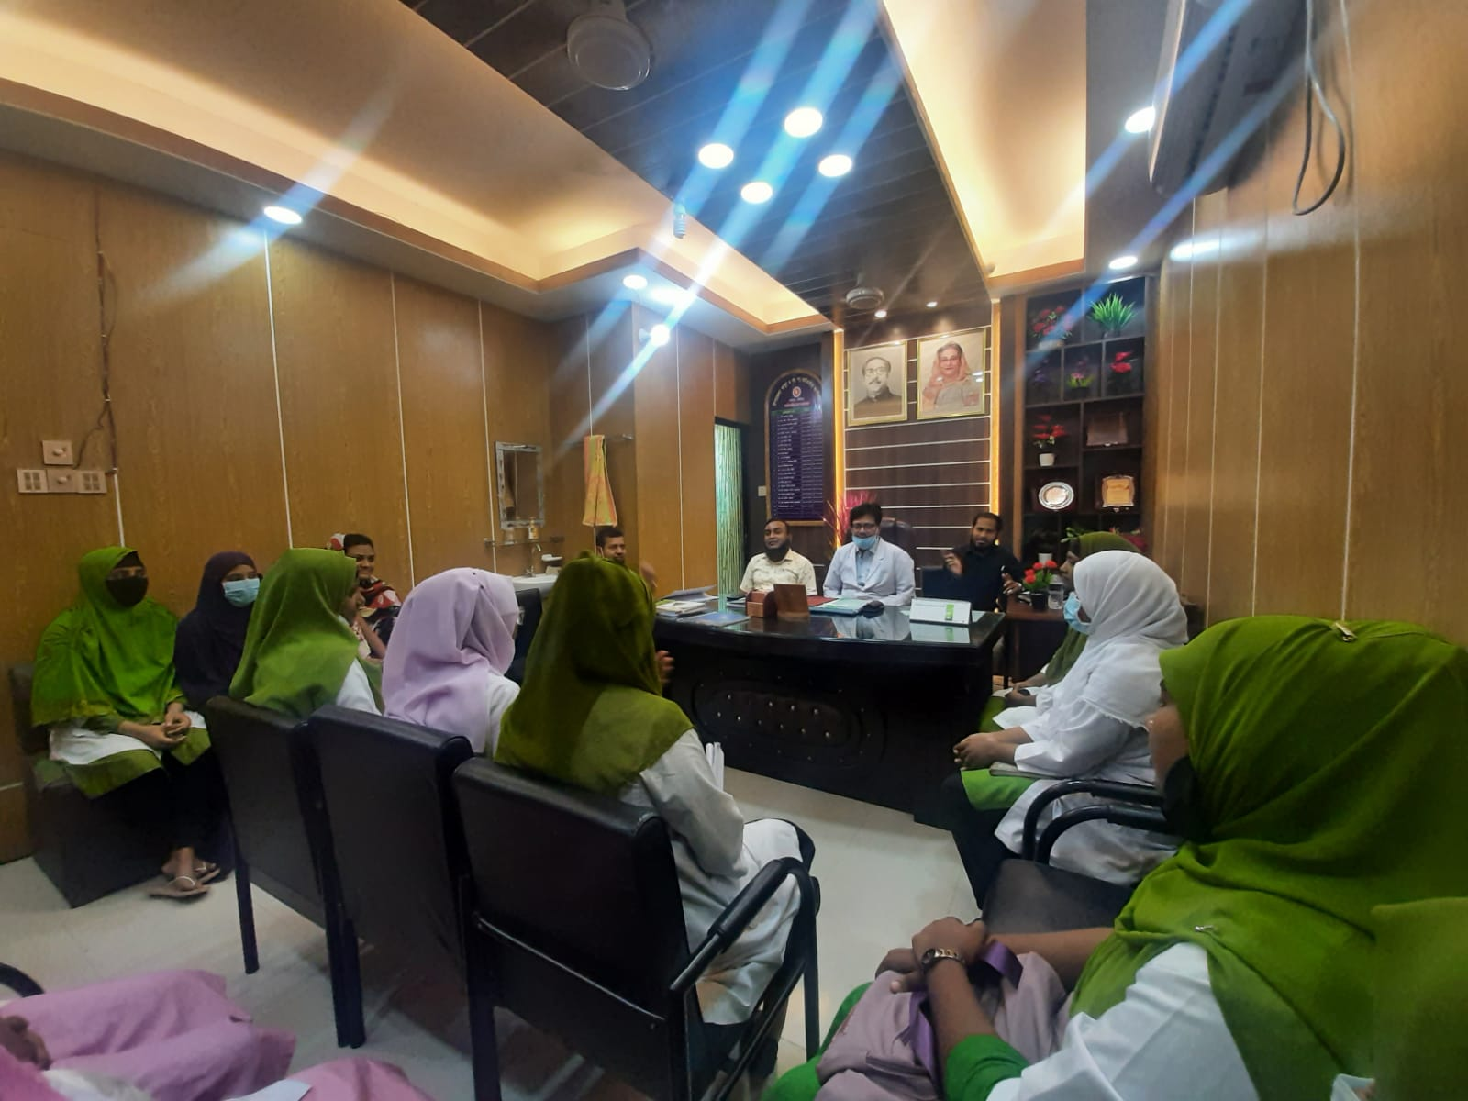
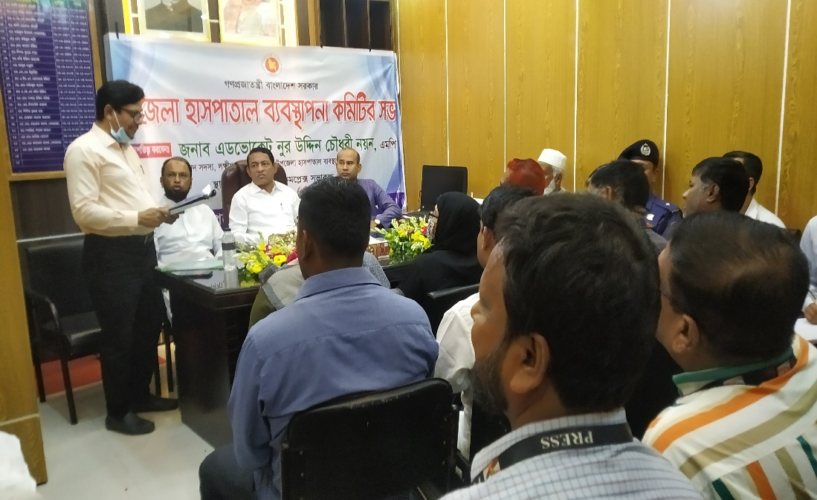
QUALITY IMPROVEMENT MEETING
NURSING STAFF MEETING
UHMC MEETING

Slide 22
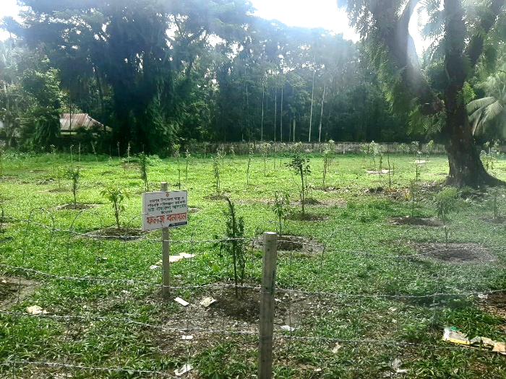
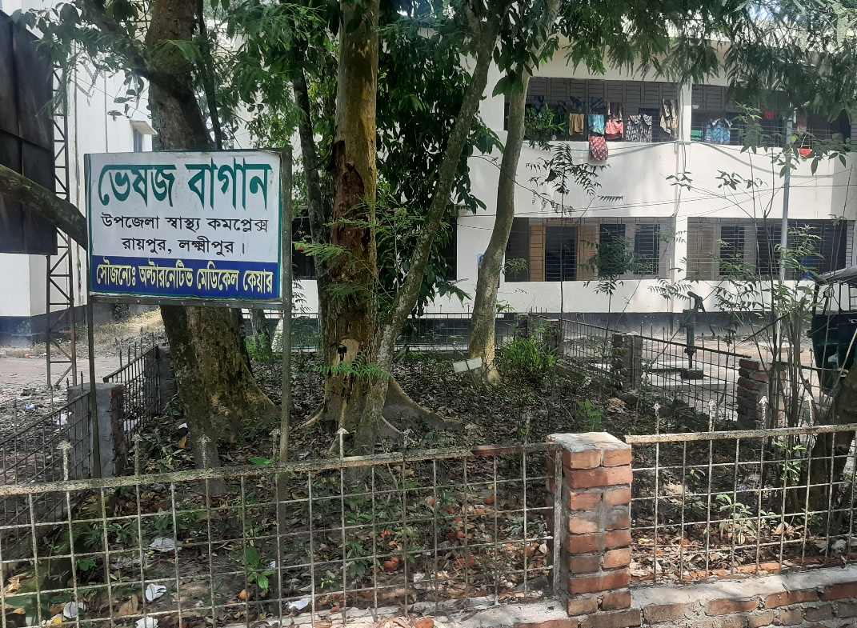
AROUND HOSPITAL AREA
GARDENING (FRUITS)
Medicinal plant

Slide 23
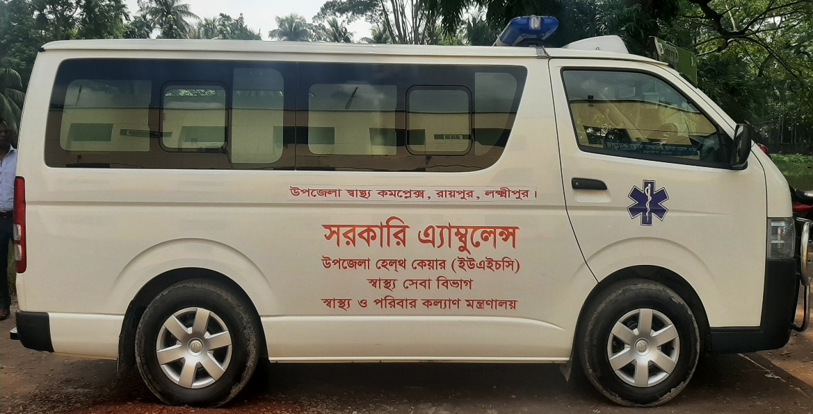
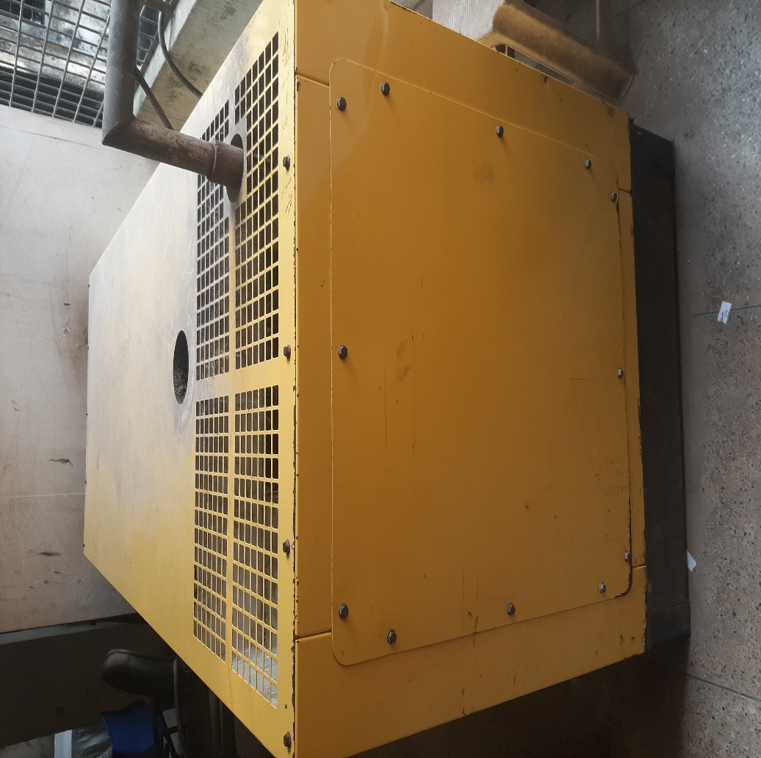
POWER SOURCES AND AMBULANCE
AMBULANCE
GENERATOR

Slide 24
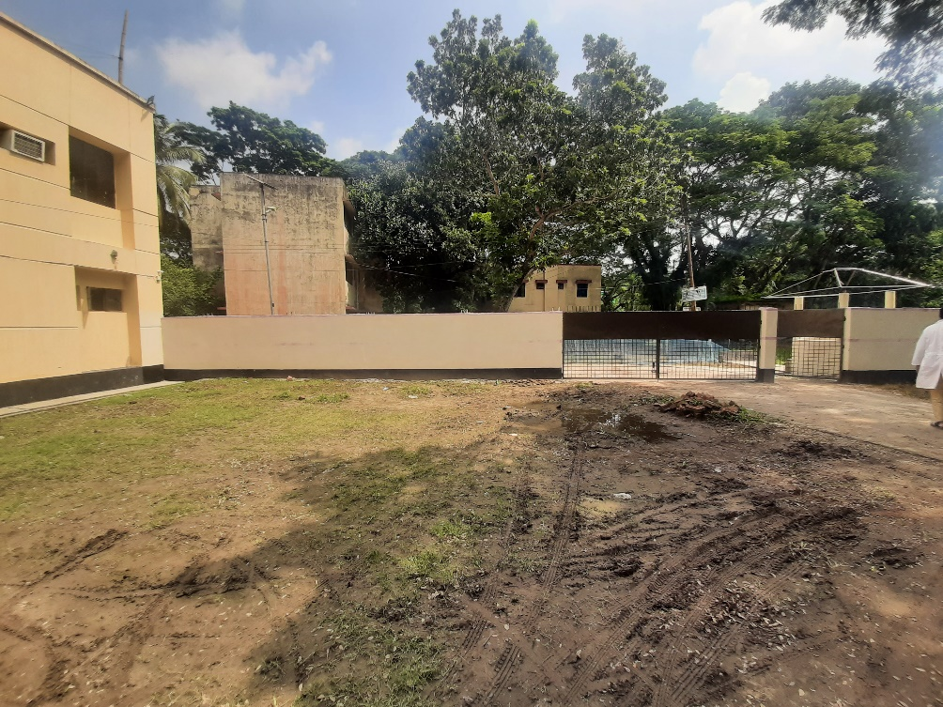
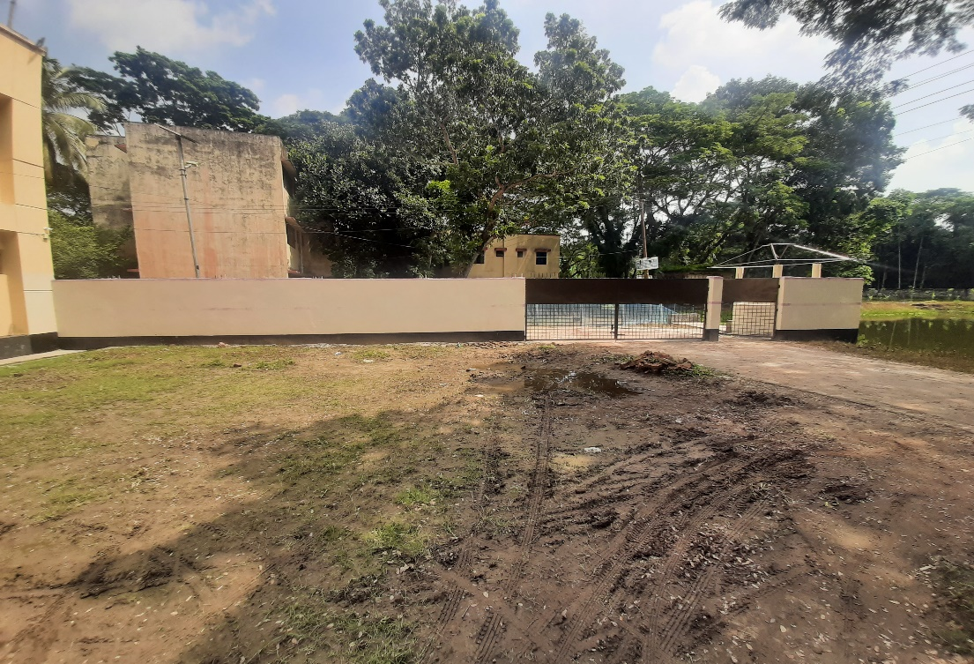
Boundary Wall OF Residential Area
BOUNDARY WALL
BOUNDARY WALL

Slide 25
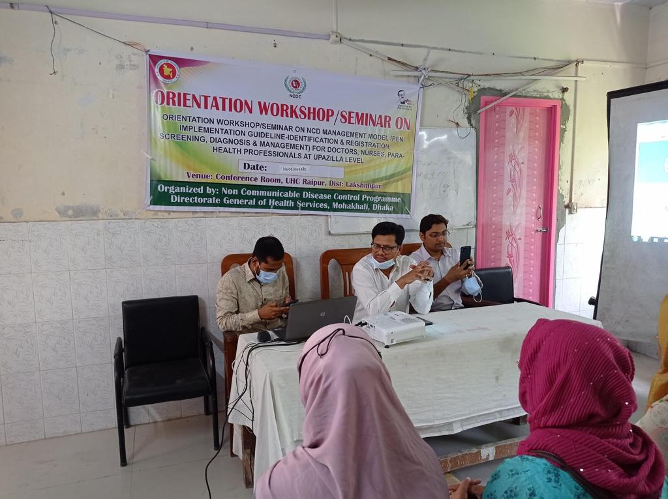
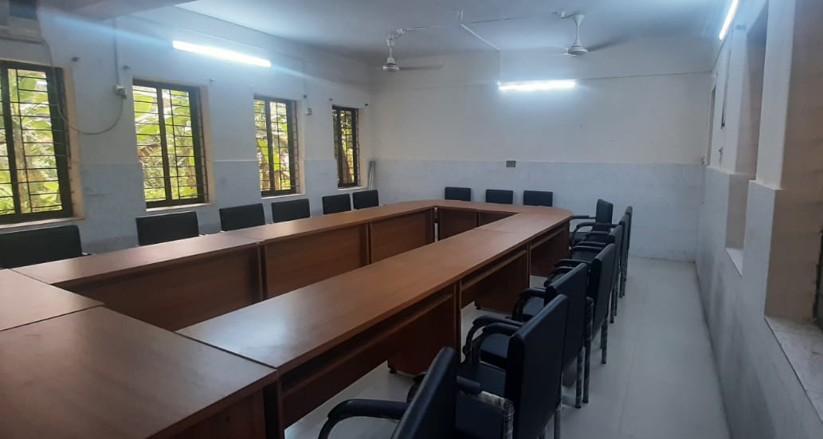
TRAINING AND RENNOVATION OF CONFERENCE HALL
TRAINING SESSION
CONFERENCE HALL

Slide 26
Upazila Health Complex
RaipurLakshmipur
Community Support
Central oxygen line has been established with the help of Upazila Parishad funded by JICA
Abul Khair Group has donated another oxygen line during the COVID-19 response
Honorable Member of Parliament has donated three air conditioners(AC) for UHC
Honorable Member of Parliament has donated another twelve ceiling fans for Ward and Different Places.

Slide 27
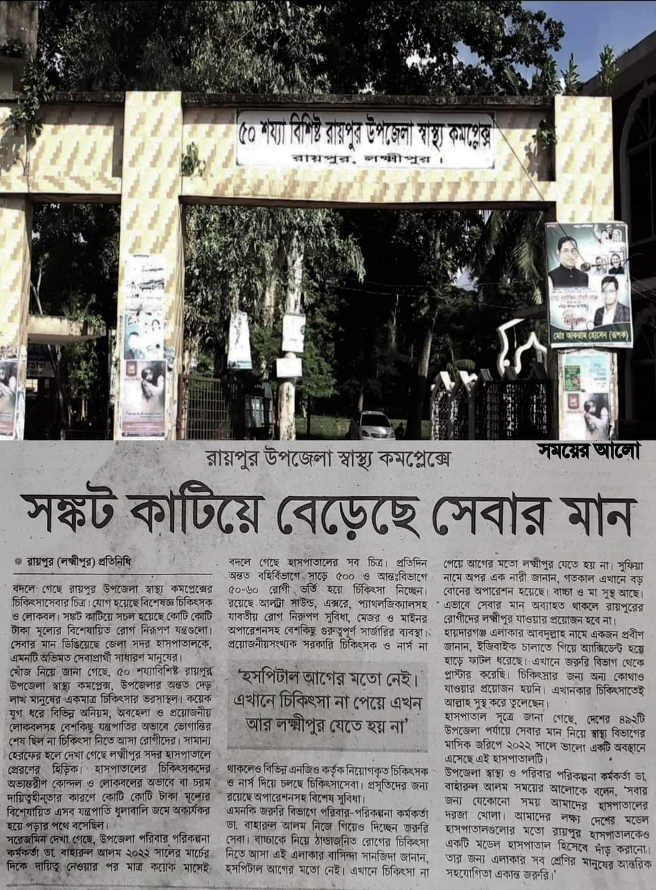
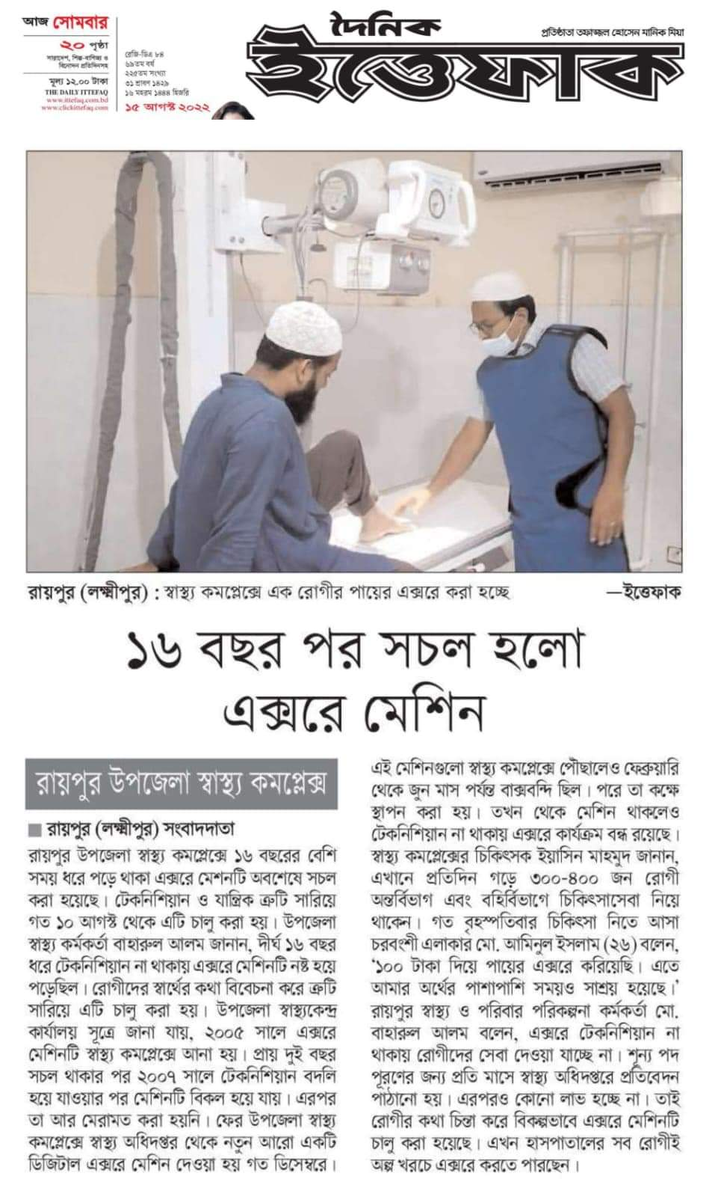
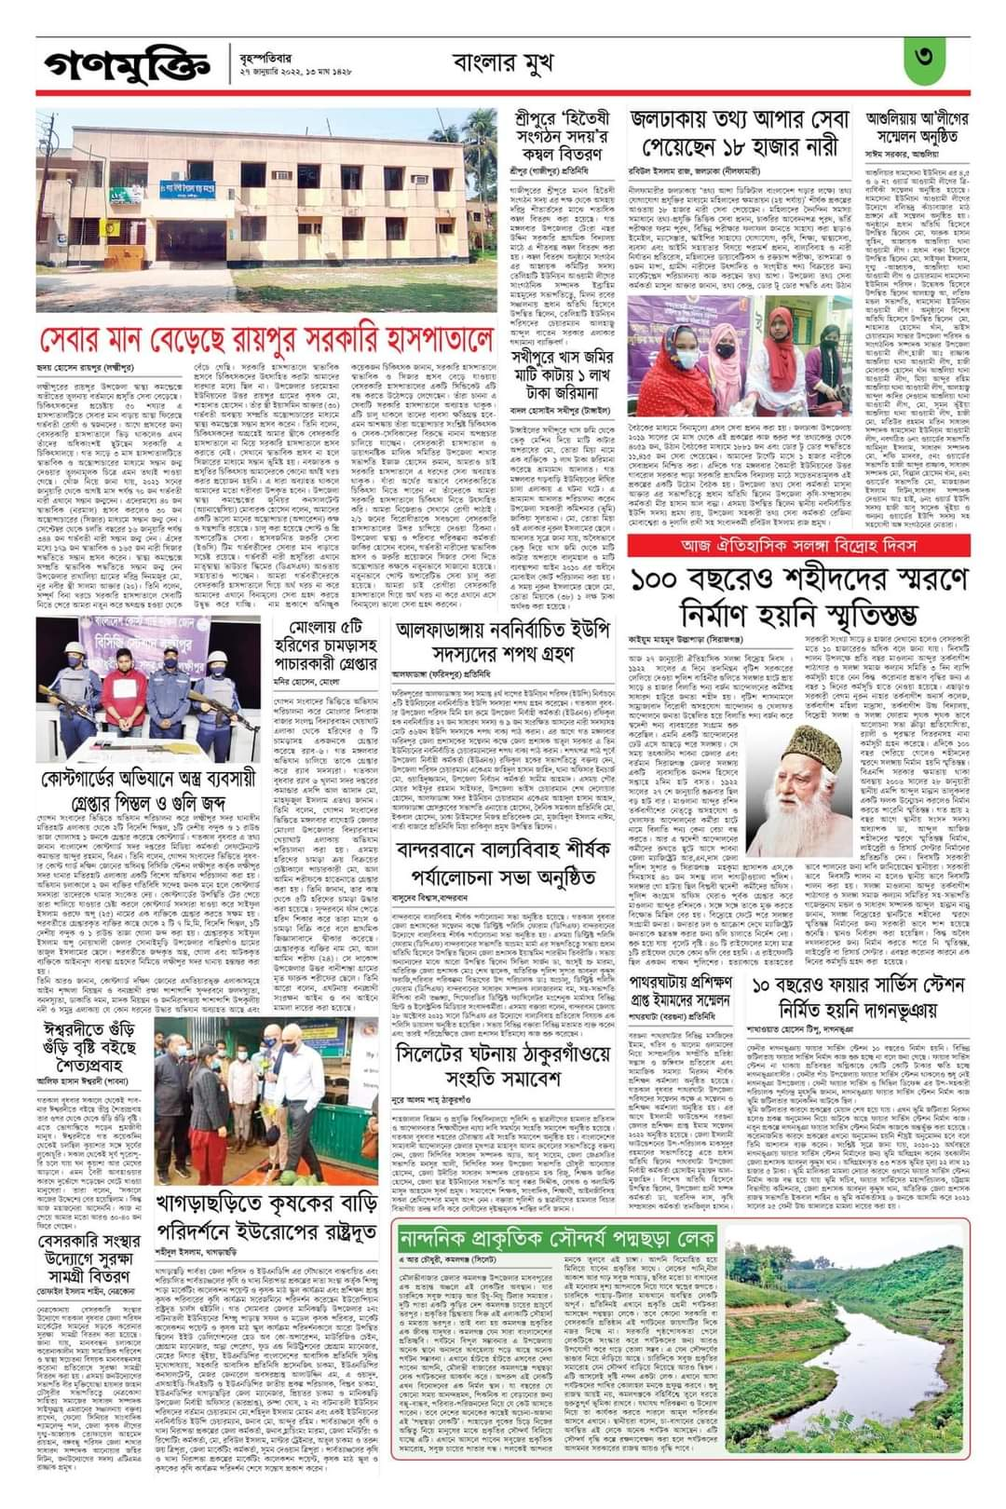
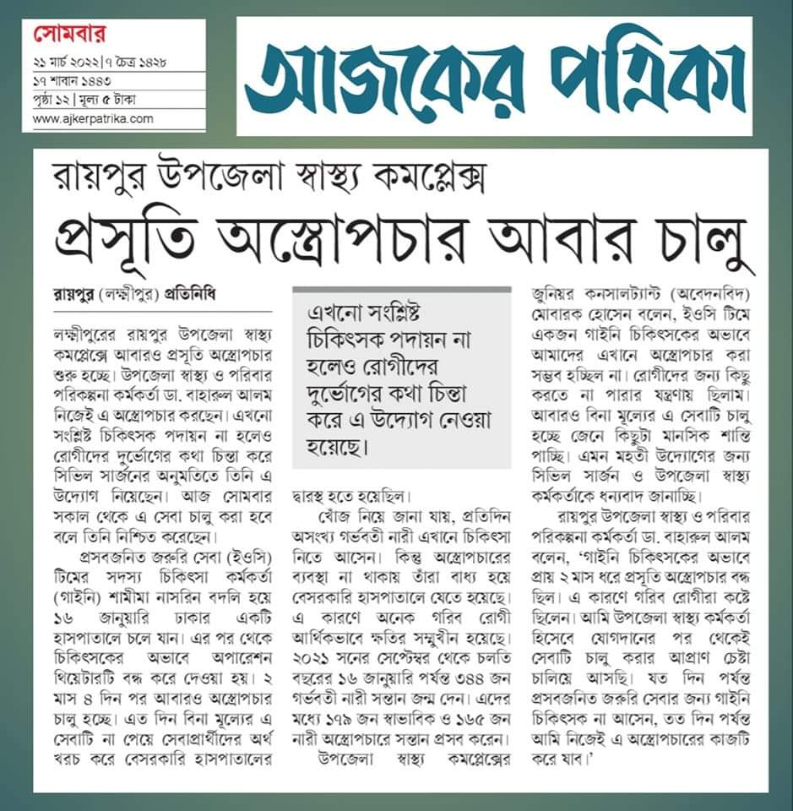
COVERAGE OF NEWPAPER

Slide 28
Achievement of Raipur Upazilla Health Complex
In 2017 , Hospital was awarded the champion for Community Health Services in Chittagong division
Corona vaccine coverage- 1st dose-72.62% and 2nd dose-70.1%
EPI coverage-99.99% in 2021.
Establishment of NCD corner.

Slide 29
Challenges
Vacant post needs to be filled urgently
No separate store room in the Hospital
Main building of the Hospital is old and reconstruction is necessary.
The quarter of officers quarter and dormitory needs urgent reconstruction.
Extra quarter needs to be build for the accommodation of doctors
Post creation of human resources of 50 bedded Hospital.

Slide 30
Way Forward….
Implementation of an effective SSK program.
Establish a parking stand close to the main gate.
Establishment of USG services soon

Slide 31
THANK YOU
Notes:
31

Slide 32
Background History of Raipur Health Complex, Lakshmipur.
To reduce Maternal and Child Mortality and Mobility and to ensure the quality services to the mother and child, UHFPO opened following special activities are continued from 2008 with the support of DGHS.
Special activities:
ANC-PNC Corner
Basic EOC service
Caesarean Section
Blood Transfusion
IMCI corner for under 5 children
Monthly birth and death record
VIA and CBE program

